Slide 1
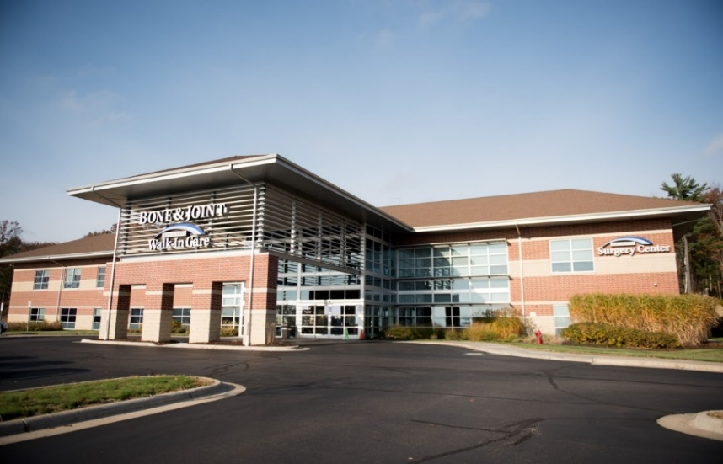
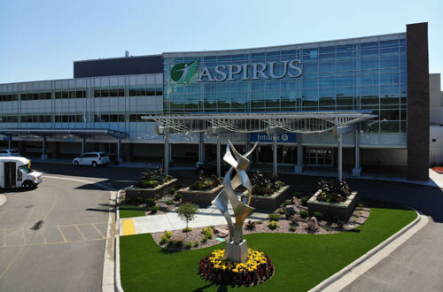
For Bone and Joint Patients Scheduled at
Aspirus Wausau Hospital and Marshfield Medical Center Weston
Total Joint Education

Slide 2


Introduction
Thank you for choosing your Bone & Joint Provider for your joint replacement surgery. Your surgery will be at Aspirus Wausau Hospital or Marshfield Medical Center Weston. Our goal is to provide you with exceptional care and the best possible experience.
Your commitment to preparation for surgery and post operative care is critical to your recovery and a successful outcome.
The majority of you will have an overnight stay at the hospital; but, if your surgeon or surgery scheduler discussed same-day discharge, then you will likely go home that day.

Slide 3
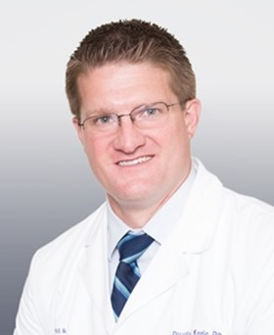
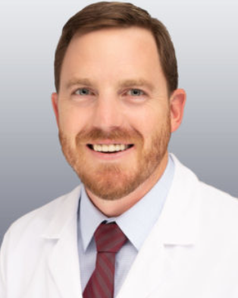
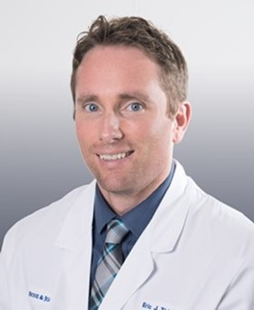



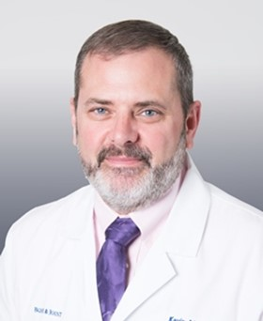
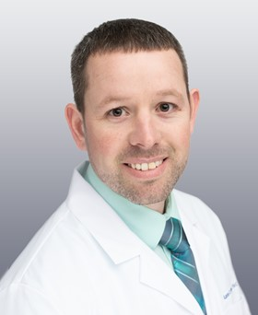

Meet our Total Joint Team
Douglas J. Keele, DO
Orthopedic & Sports Medicine Surgeon
Casey L. Lagan, MD
Orthopedic & Sports Medicine Surgeon
Eric J. Thiel, MD
Orthopedic & Sports Medicine Surgeon
Karly Nesbitt, PA-C
Stephanie M. Kniech, PA-C
Christian L. Tomski, PA-C
C. Kevin Martin, PA-C
Aaron C. Wanish, PA-C
Lindsay S. Novak, PA-C

Slide 4
Understanding Your Procedure
Bone and Joint Website:
https://bonejoint.net/
(Go to Patient Info tab, then click on Total Joint Education)
AAOS (American Association of Orthopedic Surgeons) https://orthoinfo.org/
Read your total joint guidebook thoroughly
Online information. Be sure to visit the most reputable sites

Slide 5

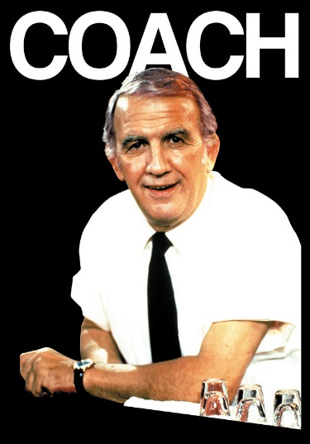
Coaches
Role of your coach
  Assist with daily activities:
    Meal prep
    Laundry
    Preparing your cold therapy unit or ice packs
    Bathing/restroom assist
    Help with exercises
    Driving to Physical Therapy
    Medications
    Encouragement
  For at least 1-2 weeks post-op

Slide 6

Dental Care
Before Surgery
After surgery
Dental clearance may be required prior to being scheduled for your joint replacement.
No dental work or cleanings 4 weeks prior to surgery.
Please let us know if you have any dental concerns (infections, cracked teeth etc.) prior to your surgery
No dental work for 6 months after surgery
Recommend for a lifetime – Use antibiotics prior to any dental work

Slide 7
Nicotine Cessation
Your surgeon requires you to stop smoking or using any nicotine products before surgery. Smoking harms oxygen circulation to your healing joint. Oxygen circulation is vital to the healing process.
Smoking can be the cause of lung cancer or other lung diseases, heart disease, and increase risk of stroke. Did you know that smoking also decreases wound healing, bone healing, and increase the chance of blood clots?

Slide 8
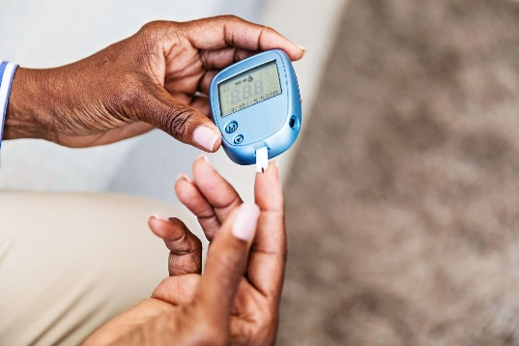

Diabetes and Surgery
Good blood sugar control helps reduce your risk of infection and other complications after surgery.
Diabetes may cause slower wound healing.
Discuss with the medical provider who manages your diabetes for the best way to manage your diabetes before and after surgery.

Slide 9

Preparing for Surgery
Drink nutritional shakes twice daily for 2 weeks before and 2 weeks after surgery to optimize healing. (example: Ensure, Boost or Glucerna.) Also, you may increase protein intake with protein bars and other products, whole meats, peanut butter, eggs, etc
Once you have a surgery date, schedule your post-operative physical therapy appointments at your location of choice as soon as possible. Therapy order will be included in your surgery letter.
Do not shave your legs within three days prior to surgery
No Manicures or Pedicures within a week of surgery. Remove all nail polish. (Infection risk)
Use the Chlorhexidine 4% soap as directed
Use the Mupirocin Ointment as directed
Do Not Donate Blood within one month of surgery

Slide 10

Preparing for Surgery (continued)
If you develop a fever, cold, rash, abrasions, cuts or other physical conditions that might concern you please contact your surgeon.
If you have had any changes in your health history or medications since your last office visit with your surgeon (example- diabetic, cardiac medications or blood thinners) please contact your surgeon.
Please notify our office if you’ve had any changes in your insurance coverage

Slide 11


Medication Instructions
When to Stop Medications That May Increase Bleeding
Anti-Inflammatory Medications-hold 5 days prior
  Advil/Ibuprofen, Aleve/Naproxen, Celebrex, Meloxicam, Diclofenac
Vitamins and Supplements-hold 7 days prior
  Examples: Vitamin E, Omega 3 Fish Oil, Garlic, Gingko, Saw Palmetto, Glucosamine and Chondroitin. Ok to continue iron and omeprazole.
Prescription Blood Thinners / Aspirin
  Take as directed by your prescribing doctor or surgeon
Acetaminophen (Tylenol) is okay to take up until surgery.
**Also, If you are taking injectable medications for diabetes or weight loss such as Ozempic, Wegovy, Mounjaro or Trulicity, hold 7 days prior.

Slide 12
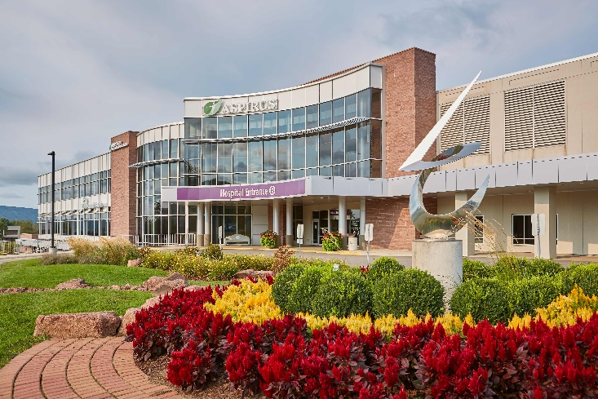
Preparations
The Aspirus Wausau Hospital PARC (Pre-surgery) Department will contact you about 3 business days before surgery with any further instructions.
PARC will also phone one business day before surgery with your arrival time, usually 1:00 PM or later.
If the hospital staff has not already contacted you, phone the pre-surgery department at 715-847-2799 between 1:30 PM and 5:00 PM the business day prior to surgery to find out your arrival time.
B-Entrance at AWH on the day of surgery.

Slide 13
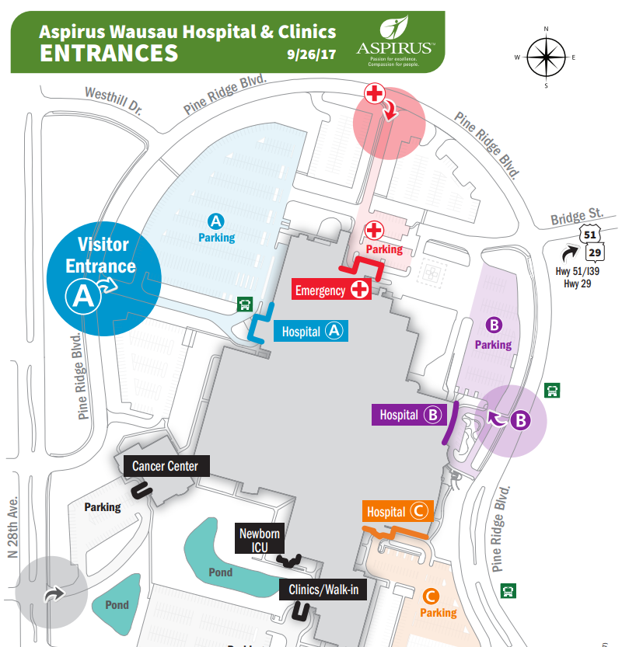
AWH Entrance B

Slide 14
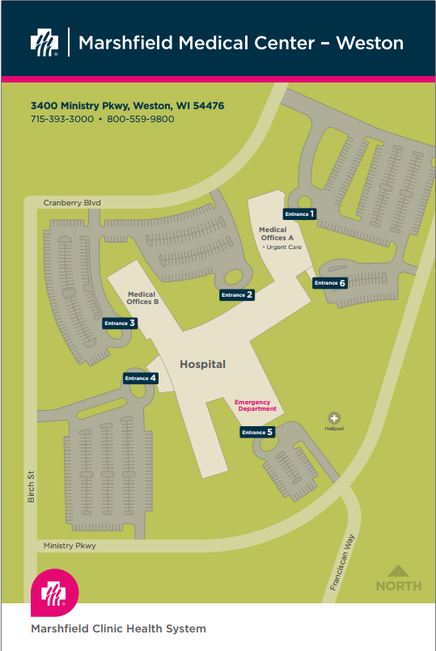
For Patients Scheduled at Marshfield Medical Center Weston
Present to Entrance #4 (Main Hospital Entrance) on the day of surgery
You will be contacted 2 business days prior to surgery with your check-in time, but if you have not received a call by 3:00 PM two days before surgery, then phone: 715-847-3391 between 8:00 AM and 4:30 PM

Slide 15
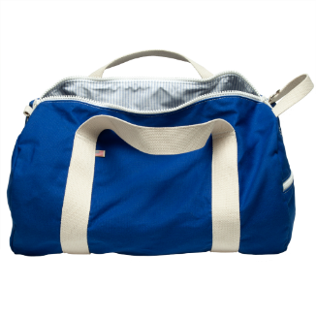
What to Bring
Walker
Overnight items (toothbrush/toothpaste)
Inhalers or eyedrops (no other home medications will be allowed)
Loose comfortable clothing to wear after surgery and for sleeping.
Well-fitting, comfortable shoes
You may bring your own C-PAP, but not required
DO NOT bring cold therapy units

Slide 16
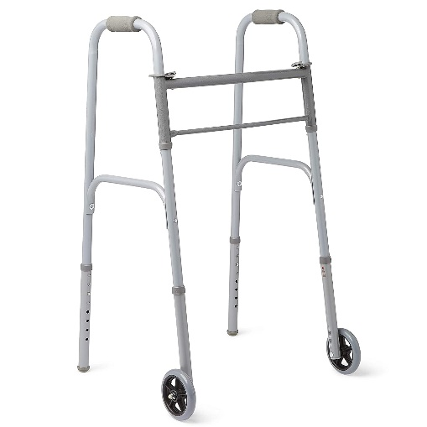
What to Bring (continued)
Leave your personal items, walkers, pillows and overnight bag in vehicle during your surgery.
Your coach will be given instructions as to where to park and when to bring your items to your room.
Label any personal items

Slide 17

Mupirocin Nasal Ointment
Why am I using this product?
Mupirocin nasal ointment is used to treat bacteria which can live in your nose and may spread to other people. It is used in particular to treat bacteria called methicillin-resistant Staphylococcus aureus (MRSA), which can cause skin infections. Although you may have MRSA in your nose and be otherwise well, it can easily spread to your new joint.

Slide 18
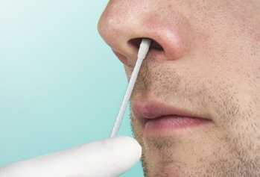
Applying Mupirocin Ointment
Wash your hands before and after you use the ointment. Use a cotton swab to apply a small amount (pea size) to the inside of each nostril. Press the sides of your nose together for a short while to allow the ointment to spread around the inside of your nostrils. Refrain from blowing or wiping your nose following the application.
Please use twice daily starting five days before your surgery and the morning of your surgery.

Slide 19
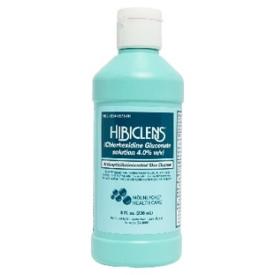
Getting Your Skin Ready
You are scheduled to have surgery that involves cutting through the skin. Because germs live on everyone’s skin, there is a greater chance for getting an infection. To lessen your chance of getting an infection, you need to take special care of your skin before the surgery.
You will be given or need to pick up a 4 or 8oz. bottle of special soap: 4% CHG (Chlorhexidine Gluconate)
You will need to shower with the CHG soap three times before your surgery. For example: If your surgery is scheduled for Tuesday then you would shower with the CHG soap on Sunday, Monday and Tuesday morning.
Do not shave near the site where your doctor will be making the incision for AT LEAST 72 HOURS prior to your surgery. Any needed “clipping” or shaving will be done prior to your surgery.
You may read in the guidebook about “Sage wipes.” You will NOT need to purchase these.

Slide 20

Cleaning Your Skin
Wash as usual with your regular shampoo and bodywash. Rinse well.
Put 1/3rd of the bottle of CHG soap on a clean, wet washcloth. Do NOT scrub too hard. Turn the water off during washing.
Wash from your neck down. Do not wash your face as the CHG can burn if it gets into your eyes and ears
Wash your body gently for (5) minutes, paying special attention to your surgical body part. Wash the back of neck, under arms, your navel (belly button), skin folds, private parts and your legs down to your toes.
Turn the shower back on and rinse well.
Pat yourself dry with a clean, dry towel
Do not use any lotions, moisturizer, make-up or any other products on the skin near your surgical body part
Put on clean clothes

Slide 21

The Day Before Your Surgery
Avoid alcohol, tobacco or illicit drugs for at least 24 hours prior to surgery.
Nothing to eat after midnight the night before your surgery, this includes chewing gum, candy or breath mints. Solids can be eaten up to 8 hours before hospital check-in. 6 oz (3/4 cup) of water can be consumed 4 hours before check-in.
Please make sure you wear clean pajamas and have clean sheets on the bed the night prior to your surgery. Please also be sure no pets are in your bed the night prior to surgery.

Slide 22
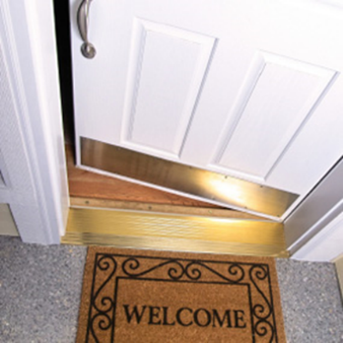
Preparing Your Home: After Surgery
Clear the hallways
Consider creating a temporary bedroom on the first floor (if able).
Remove throw rugs and area rugs
Secure all power and phone cords
Consider shower and bathroom safety
Add nightlights

Slide 23
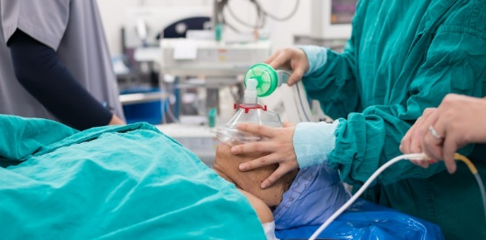
Anesthesia
Your chart will be reviewed by an anesthesiologist prior to your surgery.
You may receive a call from the anesthesiologist if there are questions regarding your medical history or problems with anesthesia in the past.
You will meet the anesthesia team just before your surgery. They will discuss the options for anesthesia with you including spinal, general and regional nerve blocks.

Slide 24
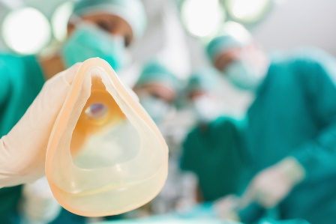
Types of Anesthesia
Spinal Anesthesia
General Anesthesia
One time injection into the back
Temporary loss of feeling and movement from approximately waist down
IV sedation for surgery
Pain control
Breathe oxygen through a mask
Medication will be administered through
IV to put you to sleep
Placement of a breathing tube
Medications for pain and/or nausea

Slide 25


Pain Control After Surgery
Anticipate that you will have more pain when your blocks or local anesthesia wears off
Be sure to follow medication schedule
Prescription Medications*
  Oral Pain Medication
    Examples: Oxycodone, Hydrocodone, Tramadol
  Anti-inflammatory medications may also be prescribed
    Example: naproxen (unless on prescription blood thinner)
*(In addition to pain medications, you will also be prescribed an antibiotic and an oral blood thinning medication)

Slide 26
Pain Control After Surgery
Nothing takes away all the pain
Prescribed medications
  May be picked up 1-2 days prior to surgery
Purpose is to help manage pain, especially with physical therapy and ambulation
Supplement with OTC medications if able
Goal is to wean off over the first 3-4 weeks
BUT, don’t be a hero!
Call for refill a few days prior to running out
May be stepped down to less strong medication

Slide 27
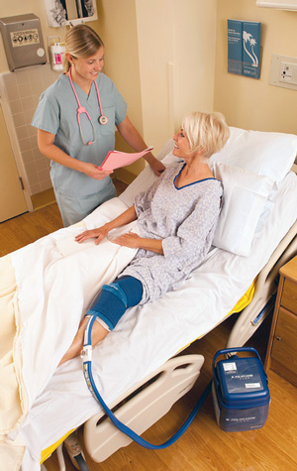
Additional Comfort Measures
Position Changes & Elevation of Extremity
“Toes Above Your Nose”
Control Swelling – Wear Compression Socks
Cold Therapy
  Home Cold Therapy Unit
  Ice Packs / Gel Packs
Get up & walk

Slide 28

Overcoming Sleep Pattern Disturbances

Slide 29
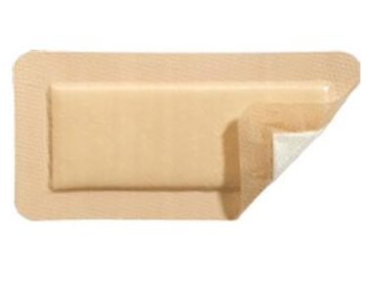
After Discharge Wound Care
Follow the surgeons' guidelines for wound care at discharge.
You may go home with a waterproof dressing called a Mepilex Dressing (for knees, hips and shoulders).
    You will likely change your dressing at 5 days post surgery. Wash your hands prior to any dressing changes.
    You may also have a mesh dressing adhered to the skin over the incision. Leave this in place until your post-operative visit.
    With the waterproof dressing, you can shower 24 hours after surgery or 24 hours after removal of a drain, but no tub bath.
You should be given an extra dressing from the hospital when you are discharged.

Slide 30
Wound Care (continued)
Bruising, swelling, warmth and some redness and some bleeding after surgery is normal.
You may have an area of pain, bruising or redness across your thigh on the surgical leg from the tourniquet used during surgery.
Notify your surgeon if there is increased drainage, redness, pain, odor, or significant heat around the incision.
Take your temperature if you are feeling warm or sick. Call your surgeon’s office if it exceeds 100.5.

Slide 31

Potential Post-Op Complications
Blood Clots
Pulmonary Embolism
Infection
Pneumonia
Constipation

Slide 32

Potential Complication –
Blood Clots /DVT
Swelling in calf, thigh, or ankle that does not go down with elevation
Pain or tenderness in calf
Do not massage
Can be either leg (operative or non operative)
Notify Physician immediately if symptoms begin

Slide 33

Potential Complications – Pulmonary Embolism
Sudden chest pains
Difficulty or rapid breathing
Shortness of breath
Sweating
Confusion
CALL 911

Slide 34
Preventing Blood Clots
Ankle pumps
Early & frequent ambulation
Compression stockings (TED hose), thigh high
  One pair will be provided at the hospital
  For an additional pair, contact Bone and Joint PT in Rib Mountain
  The patient should be present to measure for correct sizing
Blood thinners (for use 4-6 weeks after surgery)
    Aspirin (81 mg twice daily for 6 weeks) –NOT given for pain
    Xarelto
    Eliquis
    If you are already on a prescription blood thinner you will continue this medication

Slide 35
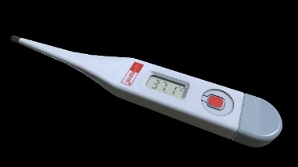
Infection Prevention
Watch for signs and symptoms of infection. Contact your surgeon if any of the following are present.
Swelling, Redness or Warmth: An incision and the surrounding tissue that increases in swelling, redness or warmth over time, or one that has red streaks radiating from it to the surrounding skin, may be infected.
Drainage from the Incision: Foul-smelling drainage or pus may start to appear on an infected incision.
Increased Pain: Your pain should slowly and steadily diminish as you heal. If your pain level at the surgical site increases for no apparent reason, you may be developing an infection.
Fever and chills: Temperature >100.5

Slide 36
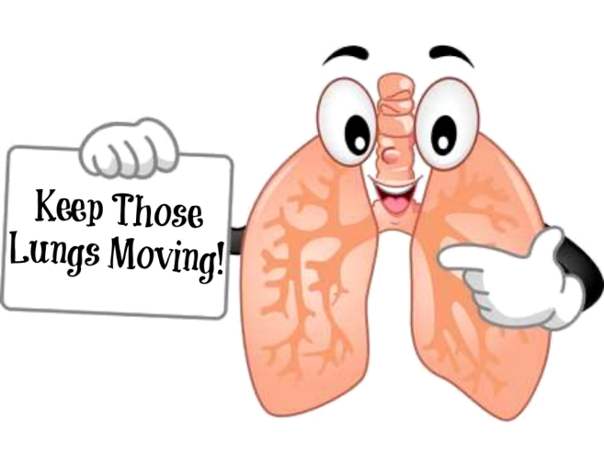
Potential Complication - Pneumonia
Cough
Shortness of Breath
Fever

Slide 37

Pneumonia
After surgery, your breathing will be shallow due to medications, pain and immobility
Not taking deep breaths will decrease the air flow into your lungs and can lead to pooling of secretions
This pooling can contribute to bacteria growth that can cause pneumonia

Slide 38

Preventing Pneumonia
Deep Breathing & Coughing
Frequent Walks
Use of your Incentive Spirometer (10 times every hour while awake)

Slide 39
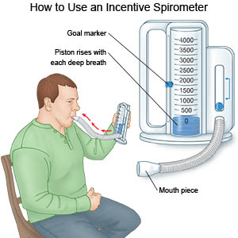
Incentive Spirometer
Sit up as straight as possible.
Hold the incentive spirometer in an upright position.
Put the mouthpiece in your mouth and close your lips tightly around it. Do not block the mouthpiece with your tongue.
Inhale slowly and deeply through the mouthpiece to raise the indicator. Try to make the indicator rise up to the level of the goal marker.
When you cannot inhale any longer, remove the mouthpiece and hold your breath for at least 3 seconds. Work up to 6 seconds…Then Exhale normally
Repeat these steps 10 times every hour when you are awake

Slide 40

Constipation
Constipation is a common occurrence after surgery caused by immobility, dehydration and pain medication.
Increase your walking.
Increase the amount of liquid you drink. Try fruit juices or water. Coffee and caffeinated sodas should be limited as they dehydrate rather than hydrate.
Add fiber to your diet by eating whole wheat bread, bran cereals, fruit, fruit juices, vegetables.
Stool softeners (Colace®) or fiber supplements (Metamucil® or Miralax®) can add bulk to your diet and can be purchased without a prescription.
Recommend purchasing OTC stool softener caplets and begin using daily after surgery while on post-op pain medications.
Sometimes, despite trying the above measures, you still may become constipated. If you feel constipated, or have not had a bowel movement for three (3) days, you can try one of the following:
  A mild laxative such as Milk of Magnesia® or Ex-Lax®.
  A laxative suppository can be purchased at a pharmacy without a prescription.
  A small enema can be purchased at a drug store under the name “Fleets” enema.
If you do not have a bowel movement after trying these measures, call Bone and Joint.

Slide 41

Driving
May be up to 6-8 weeks
Factors
  Type of surgery (Hip vs Knee)
  Laterality (Right vs Left)
  Opioid pain medications
  Quad (thigh muscle) strength
  Assistive devices
Discuss with your surgeon or Physician Assistant and your Physical Therapist as to when you may begin driving.

Slide 42
Post-op Rehab Facilities
If you do not have help at home or have medical reason why you cannot go home following surgery
  It may be possible to go to a Rehab facility such as Rennes, Pride TLC, Pinecrest, etc for 2-3 weeks.
  If you are concerned about not having someone to help you at home after surgery, discuss this with your surgeon’s team or surgery scheduler.
Bone and Joint does not coordinate your Rehab stays after surgery
  We will, however, place an order for the Discharge Planner so they are aware of this need
The patient and family should start to coordinate with a Rehab facility prior to surgery
Home PT/OT is discouraged, outcomes are often not as good
Home Nursing care is often not medically necessary and may be out of pocket cost

Slide 43
Post-op Rehab Facilities
Having insurance benefits for Rehab doesn’t mean you will qualify
  To qualify for skilled nursing facility (SNF) extended care services coverage, Medicare patients must meet the 3-day rule before SNF admission. The 3-day rule requires the patient have a medically necessary 3-consecutive-day inpatient hospital stay, which doesn’t include the discharge day
You should have a back up plan for your post-op care
  May need to postpone your surgery until you have help at home
  Speak with your insurance company regarding your specific situation

Slide 44

Disability/Family Medical Leave
Please contact our Patient Document Specialist for any questions regarding Short Term Disability or FMLA paperwork
Phone number (715) 359-6442 ext. 1601
Fax number (715) 393-0390
Submit this paperwork around 4-6 weeks before your surgery
Also complete a release of information form for any insurance companies or 3rd party payers
We are also able to complete this paperwork for your coaches/family member who will be helping you after surgery

Slide 45

For Any Questions
Before surgery -Your Ortho Nurse Coordinator or Surgery Schedulers are available to guide and assist you with any questions or concerns
After surgery - Please always call and speak with a Bone and Joint triage nurse, 800-445-6442 extension 5000, or contact your surgeon’s team with any questions or concerns. If your surgery is at Marshfield Medical Center, please do not contact that facility with concerns afterwards. You may inadvertently be directed to a Marshfield Clinic provider rather than your Bone and Joint team.
Also, Bone and Joint on-call providers are always available after business hours, weekends and holidays.
Thank You
For Choosing Bone & Joint!

